Slide 1
Dentations and Aging of cattle
Dentations and Aging of cattle

Slide 2
We can dentations and Aging of cattle by the following methods
1-By the Horns (in some breeds )
* The horns appear at age (3)months ,like small plugging on the side of head .
*At age (5) months ,the long of horn is (3)cm
*At age (1)year the long of horn reach to (10)cm.
*At age (1,5)year reach the horn to (15)cm
*After that the ring appear on the horns and the first Ring appear at age (2) years and each year appear another Ring .

Slide 3
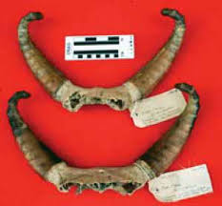

Slide 4
2-The numbers of births
We can depending on this methods, if the time of birth constant at each year depending on the birth records .
3-Dentation
*The cattle has (4)pairs of incisors in the lower jaw .
*The upper jaw present the Dental pad .
*The shape of incisors like the ( spatula shape )
*No canines in temporary or permanent teeths.
*The animal has (6)molars on each side of lower and upper jaw of adult animal .

Slide 5
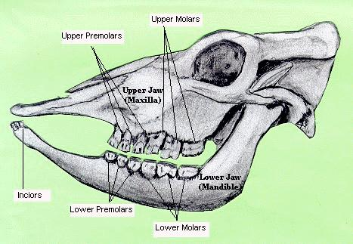

Slide 6
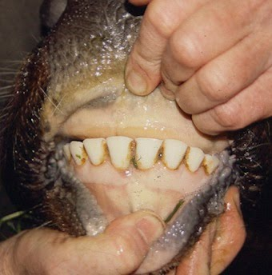

Slide 7
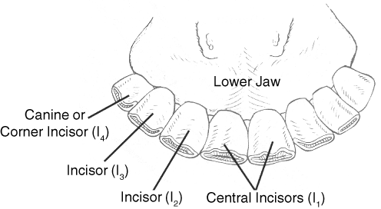

Slide 8
Temporary Dental Formulas (male and female)
I c m
0 0 3
---------------------------------------- =10x2=20
4 0 3
The time of appear of Temporary teeth in cattle
*The centrals and medial appear at birth and complete
Growth at age (2)weeks old
*From (2) to(4) weeks appear the sudacy and corner
teeth and the first three molars , the temporary teeth continue in growth until the upper and lower jaw applies at age (6)months.

Slide 9
Permanent Dental Formula (male and female)
I c m
0 0 3+3
-----------------------------------------------=16x2=32
4 0 3+3
The time of appears of Permanent teeth in cattle
*At age (6)months appear the (fourth molar ) as Permanent.
*At age (15)month old appear the (fifth molar)as
Permanent .
*The centrals and the first and second molar
Change to permanent at age (1,9-2)years old
*The sixth molar appear as permanent at age (1,9 - 2)years.
*The third molar change to permanent at age
(2,9)years .
*The medial change to permanent at age(2,5-3)
Years and the sudacy at age (3,5-4)years .
*At age (4,3-4,5) years the corners change to
Permanent .

Slide 10
Permanent Tooth Eruption in Cattle
 | Level and Neck Emerged from Gum | In Wear | Age at Eruption | Permanent Tooth
 | 6 years | All at 5 years | 1.5-2 years | Incisor (I₁)
 | 7 years |  | 2-2.5 years | Incisor (I₂)
 | 8 years |  | 3 years | Incisor (I₃)
 | 9 years |  | 3.5-4 years | Incisor (I₄)

Slide 11
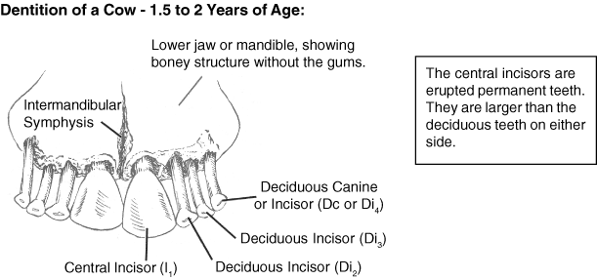

Slide 12
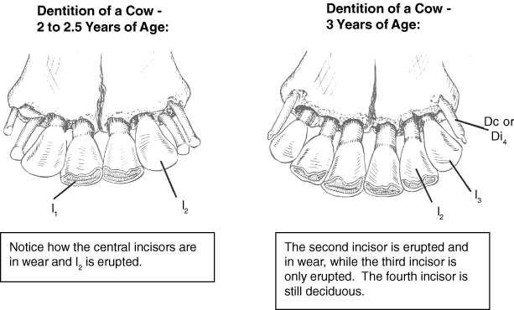

Slide 13
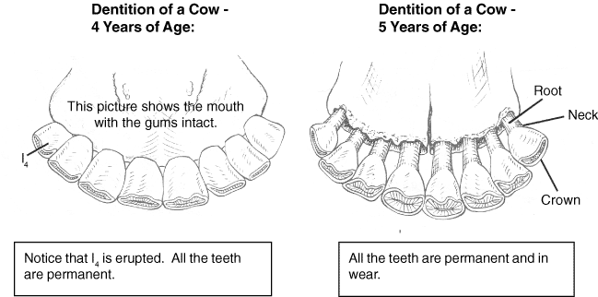

Slide 14
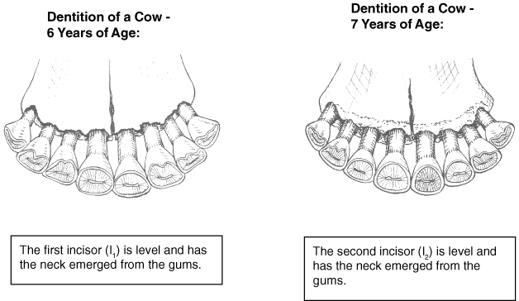

Slide 15
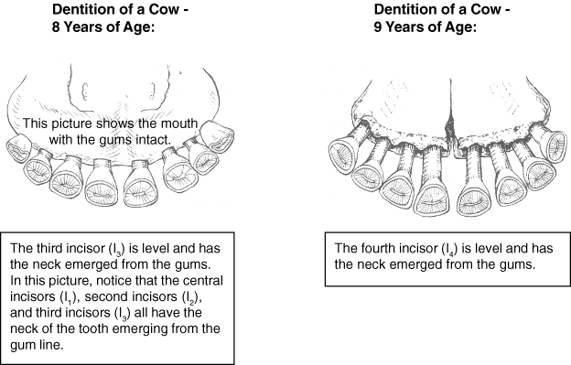

Slide 16
